Slide 1
AI for Medicine
Lecture 23:
Deep Learning – Part III
April 18, 2022
Mohammad Hammoud
Carnegie Mellon University in Qatar

Slide 2
Today…
Last Monday’s Session:
  Quiz II and Deep Learning – Part II
Today’s Session:
  Deep Learning – Part III
Announcements:
  Quiz II grades are out
  The final exam is on Thursday, April 28 from 8:30AM to 11:30AM
    15-182: In the Moot Ball Room
    15-282: In Room 1064

Slide 3
Outline
Deep Learning
Overview
Vectorization
Computation Graph
Gradient Descent

Slide 4




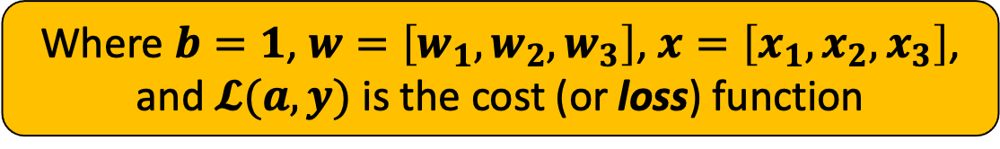









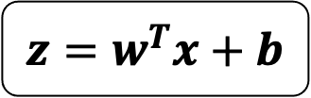





The Computation Graph of Logistic Regression
Let us translate logistic regression (which is a neural network with only 1 neuron) into a computation graph
$$1$$
$$b$$
$$z=w^{T}x+b$$
$$x_{1}$$
$$w_{1}$$
$$b$$
$$x_{2}$$
$$w_{2}$$
$$\hat{y}$$
$$x$$
$$z=w^{T}x+b$$
$$a=σ(z)$$
$$𝓛(a,y)$$
$$z$$
$$a$$
$$w_{3}$$
$$w$$
$$x_{3}$$
$$a=σ(z)$$
Where $b=1$, $w=\left[w_{1},w_{2},w_{3}\right]$, $x=\left[x_{1},x_{2},x_{3}\right]$, and $𝓛(a,y)$ is the cost (or loss) function

Slide 5
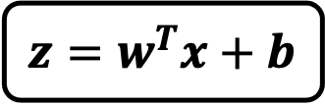

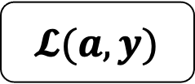
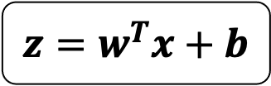


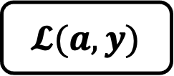

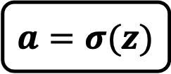
Forward Propagation
The loss function can be computed by moving from left to right
$$b$$
$$z=w^{T}x+b$$
$$𝓛(a,y)$$
$$z=w^{T}x+b$$
$$a=σ(z)$$
$$𝓛(a,y)$$
$$x$$
$$a=σ(z)$$
$$w$$

Slide 6
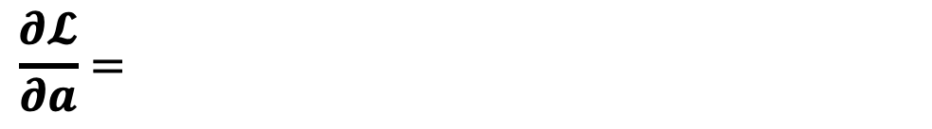

Backward Propagation
The derivatives can be computed by moving from right to left
$$b$$
$$x$$
$$z=w^{T}x+b$$
$$a=σ(z)$$
$$𝓛(a,y)$$
$$w$$
$$\frac{∂𝓛}{∂a}=\frac{∂}{∂a}\left(−ylog\left(a\right)−\left(1−y\right)log\left(1−a\right)\right)$$
Partial derivative of $𝓛$ with respect to $a$

Slide 7
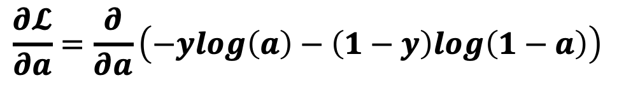
Backward Propagation
The derivatives can be computed by moving from right to left
$$b$$
$$x$$
$$z=w^{T}x+b$$
$$a=σ(z)$$
$$𝓛(a,y)$$
$$w$$
$$\frac{∂𝓛}{∂a}=\frac{∂}{∂a}\left(−ylog\left(a\right)−\left(1−y\right)log\left(1−a\right)\right)$$

Slide 8
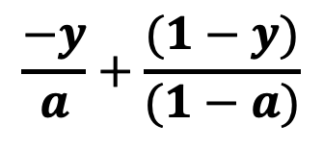
Backward Propagation
The derivatives can be computed by moving from right to left
$$b$$
$$x$$
$$z=w^{T}x+b$$
$$a=σ(z)$$
$$𝓛(a,y)$$
$$w$$
$$\frac{−y}{a}+\frac{(1−y)}{(1−a)}$$
$$\frac{∂𝓛}{∂a}=\frac{∂}{∂a}\left(−ylog\left(a\right)−\left(1−y\right)log\left(1−a\right)\right)$$

Slide 9
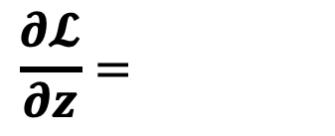

Backward Propagation
The derivatives can be computed by moving from right to left
$$b$$
$$x$$
$$z=w^{T}x+b$$
$$a=σ(z)$$
$$𝓛(a,y)$$
$$w$$
$$\frac{∂𝓛}{∂z}=\frac{∂𝓛}{∂a}×\frac{∂a}{∂z}$$
Partial derivative of $𝓛$ with respect to $z$

Slide 10
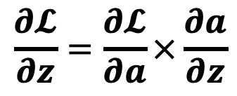
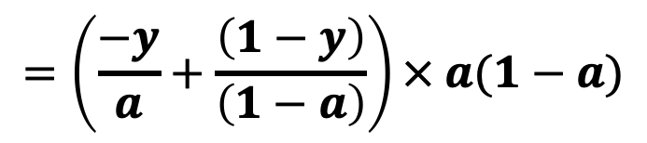
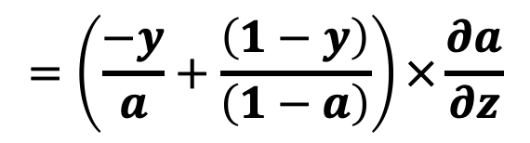
Backward Propagation
The derivatives can be computed by moving from right to left
$$b$$
$$x$$
$$z=w^{T}x+b$$
$$a=σ(z)$$
$$𝓛(a,y)$$
$$w$$
$$\frac{∂𝓛}{∂z}=\frac{∂𝓛}{∂a}×\frac{∂a}{∂z}$$
$$=\left(\frac{−y}{a}+\frac{\left(1−y\right)}{\left(1−a\right)}\right)×\frac{∂a}{∂z}$$
$$=\left(\frac{−y}{a}+\frac{\left(1−y\right)}{\left(1−a\right)}\right)× a(1−a)$$

Slide 11

Backward Propagation
The derivatives can be computed by moving from right to left
$$b$$
$$x$$
$$z=w^{T}x+b$$
$$a=σ(z)$$
$$𝓛(a,y)$$
$$w$$
$$\frac{∂𝓛}{∂z}=\frac{∂𝓛}{∂a}×\frac{∂a}{∂z}$$
$$a−y$$

Slide 12
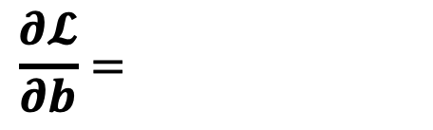

Backward Propagation
The derivatives can be computed by moving from right to left
$$b$$
$$x$$
$$z=w^{T}x+b$$
$$a=σ(z)$$
$$𝓛(a,y)$$
$$w$$
$$\frac{∂𝓛}{∂b}=\frac{∂𝓛}{∂a}×\frac{∂a}{∂z}×\frac{∂z}{∂b}$$
Partial derivative of $𝓛$ with respect to $b$

Slide 13
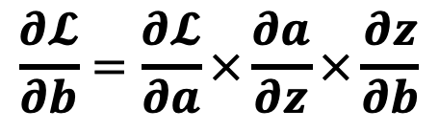


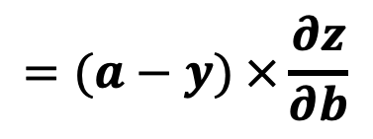
Backward Propagation
The derivatives can be computed by moving from right to left
$$b$$
$$x$$
$$z=w^{T}x+b$$
$$a=σ(z)$$
$$𝓛(a,y)$$
$$w$$
$$\frac{∂𝓛}{∂b}=\frac{∂𝓛}{∂a}×\frac{∂a}{∂z}×\frac{∂z}{∂b}$$
$$=(a−y) ×\frac{∂z}{∂b}$$
$$=(a−y) ×1$$
$$=(a−y)$$

Slide 14
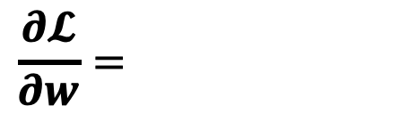

Backward Propagation
The derivatives can be computed by moving from right to left
$$b$$
$$x$$
$$z=w^{T}x+b$$
$$a=σ(z)$$
$$𝓛(a,y)$$
$$w$$
$$\frac{∂𝓛}{∂w}=\frac{∂𝓛}{∂a}×\frac{∂a}{∂z}×\frac{∂z}{∂w}$$
Partial derivative of $𝓛$ with respect to $w$

Slide 15
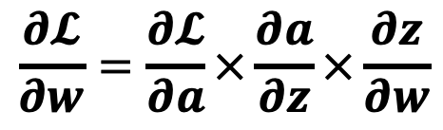

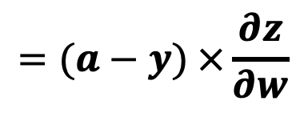
Backward Propagation
The derivatives can be computed by moving from right to left
$$b$$
$$x$$
$$z=w^{T}x+b$$
$$a=σ(z)$$
$$𝓛(a,y)$$
$$w$$
$$\frac{∂𝓛}{∂w}=\frac{∂𝓛}{∂a}×\frac{∂a}{∂z}×\frac{∂z}{∂w}$$
$$=(a−y) ×\frac{∂z}{∂w}$$
$$=(a−y)x$$

Slide 16

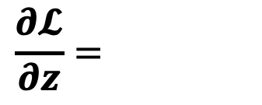


Backward Propagation: Summary
Here is the summary of the gradients in logistic regression:
$$\frac{∂𝓛}{∂z}=\frac{∂𝓛}{∂a}×\frac{∂a}{∂z}$$
$$dz=$$
$$a−y$$
We will denote this as $dz$ for simplicity

Slide 17



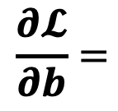


Backward Propagation: Summary
Here is the summary of the gradients in logistic regression:
$$\frac{∂𝓛}{∂z}=\frac{∂𝓛}{∂a}×\frac{∂a}{∂z}$$
$$dz=$$
$$a−y$$
$$\frac{∂𝓛}{∂b}=$$
$$db=$$
$$a−y$$
$$\frac{∂𝓛}{∂w}=$$
$$dw=$$
$$(a−y)x$$

Slide 18
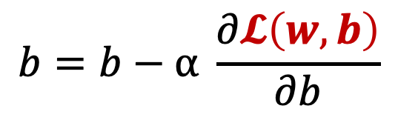
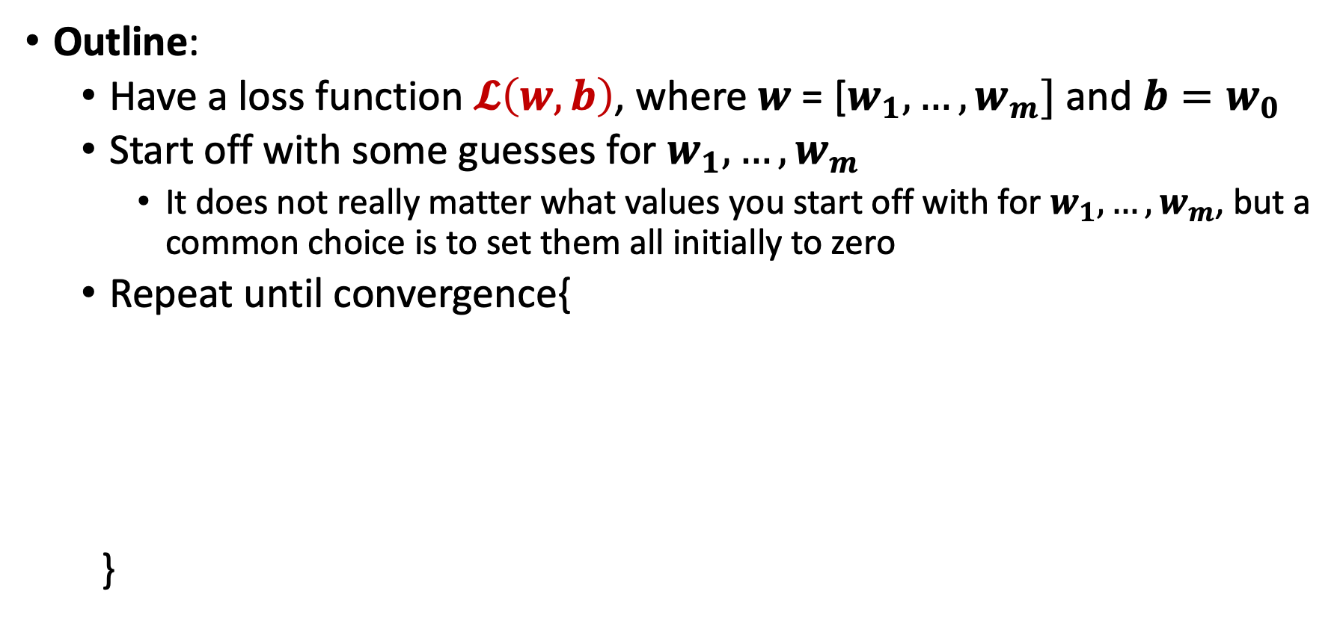
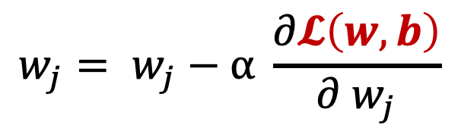
Gradient Descent For Logistic Regression
Outline:
  Have a loss function $𝓛\left(w,b\right)$, where $w \text{= [}w_{1}, …,w_{m}]$ and $b=w_{0}$
  Start off with some guesses for $w_{1}, …, w_{m}$
    It does not really matter what values you start off with for $w_{1}, …, w_{m}$, but a common choice is to set them all initially to zero
  Repeat until convergence{
  }
$$w_{j}= w_{j}−α \frac{∂𝓛\left(w,b\right)}{∂{ w}_{j}}$$
Let us focus
on this part
$$b=b−α \frac{∂𝓛\left(w,b\right)}{∂b}$$

Slide 19

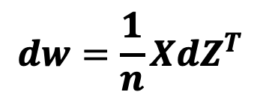

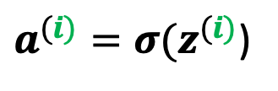






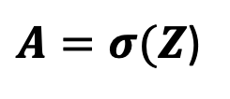






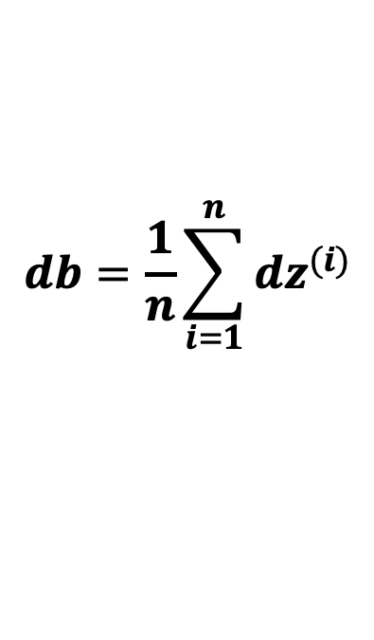
Gradient Descent For Logistic Regression
Assuming $n$ examples
Outline:
  Repeat until convergence{
  }
$$for i=1 to n:$$
$$Z=w^{T}X+b$$
$$z^{(i)}=w^{T}x^{(i)}+b$$
Forward
propagation
$A=σ(Z$)
$a^{(i)}=σ(z^{(i)}$)
Vectorized version
$$dZ=A−Y$$
Backward
propagation
$${dz}^{(i)}=a^{(i)}−y^{(i)}$$
$$dw=\frac{1}{n}X{dZ}^{T}$$
$$dw={dw+dz}^{(i)}x^{(i)}$$
$$db={db+dz}^{(i)}$$
$$db=\frac{1}{n}\sum_{i=1}^{n}{{dz}^{(i)}}$$
$$dw=dw/n$$
Outside
the loop
$$db=db/n$$
$$w=w−αdw$$
$$w=w−αdw$$
$$b=b−αdb$$
$$b=b−αdb$$

Slide 20

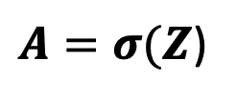


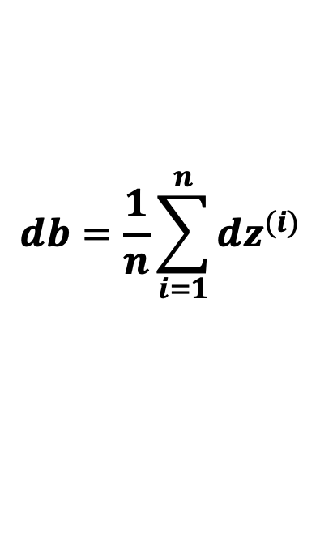
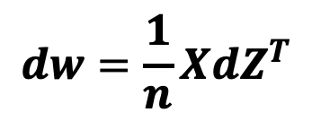

Gradient Descent For Logistic Regression
Outline:
  Repeat until convergence{
  }
$$Z=w^{T}X+b$$
$A=σ(Z$)
$$dZ=A−Y$$
$$dw=\frac{1}{n}X{dZ}^{T}$$
$$db=\frac{1}{n}\sum_{i=1}^{n}{{dz}^{(i)}}$$
$$w=w−αdw$$
$$b=b−αdb$$

Slide 21















The Computation Graph of A Neural Network
Akin to logistic regression, we can represent any neural network in terms of a computation graph
$$z_{1}^{[1]}$$
$$a_{1}^{[1]}$$
$${x=a}^{[0]}$$
$$x_{1}$$
$$z_{2}^{[1]}$$
$$a_{2}^{[1]}$$
A neural network
with 2 layers
$$x_{2}$$
$$z_{1}^{[2]}$$
$$a_{1}^{[2]}$$
$$\hat{y}$$
$$z_{3}^{[1]}$$
$$a_{3}^{[1]}$$
$$x_{3}$$
Layer 2
$$z_{4}^{[1]}$$
$$a_{4}^{[1]}$$
Input Layer
(or Layer 0)
Layer 1

Slide 22
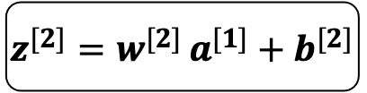


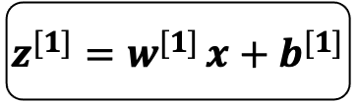






The Computation Graph of A Neural Network
Akin to logistic regression, we can represent any neural network in terms of a computation graph
$$b^{[2]}$$
$$b^{[1]}$$
$$W^{[2]}$$
$$x$$
$$z^{[1]}=w^{[1] }x+b^{[1]}$$
$$a^{[1]}=σ(z^{[1]})$$
$$z^{[2]}=w^{[2] }a^{[1]}+b^{[2]}$$
$$a^{[2]}=σ(z^{[2]})$$
$$𝓛(a^{[2]},y)$$
$$W^{[1]}$$
The corresponding computation graph

Slide 23
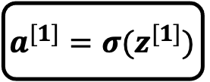
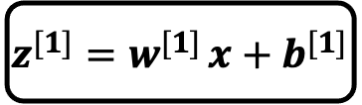

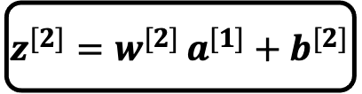
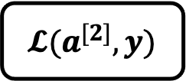
Forward Propagation
The loss function can be computed by moving from left to right
$$b^{[2]}$$
$$b^{[2]}$$
$$W^{[2]}$$
$$b^{[1]}$$
$$W^{[2]}$$
$$b^{[1]}$$
$$a^{[2]}=σ(z^{[2]})$$
$$a^{[2]}=σ(z^{[2]})$$
$$𝓛(a^{[2]},y)$$
$$a^{[1]}=σ(z^{[1]})$$
$$𝓛(a^{[2]},y)$$
$$a^{[1]}=σ(z^{[1]})$$
$$z^{[2]}=w^{[2] }a^{[1]}+b^{[2]}$$
$$z^{[1]}=w^{[1] }x+b^{[1]}$$
$$z^{[2]}=w^{[2] }a^{[1]}+b^{[2]}$$
$$x$$
$$z^{[1]}=w^{[1] }x+b^{[1]}$$
$$x$$
$$W^{[1]}$$
$$W^{[1]}$$

Slide 24
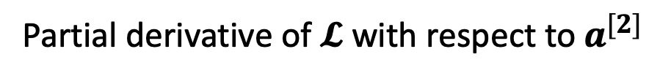
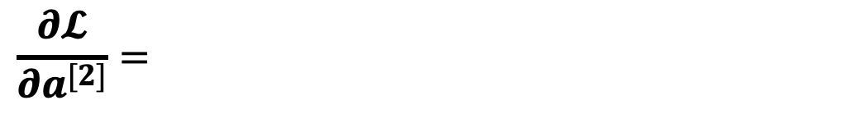
Backward Propagation
The derivatives can be computed by moving from right to left
$$b^{[2]}$$
$$b^{[1]}$$
$$W^{[2]}$$
$$x$$
$$z^{[1]}=w^{[1] }x+b^{[1]}$$
$$a^{[1]}=σ(z^{[1]})$$
$$z^{[2]}=w^{[2] }a^{[1]}+b^{[2]}$$
$$a^{[2]}=σ(z^{[2]})$$
$$𝓛(a^{[2]},y)$$
$$W^{[1]}$$
$$\frac{∂𝓛}{∂a^{[2]}}=\frac{∂}{∂a}\left(−ylog\left(a\right)−\left(1−y\right)log\left(1−a\right)\right)$$
Partial derivative of $𝓛$ with respect to $a^{[2]}$

Slide 25
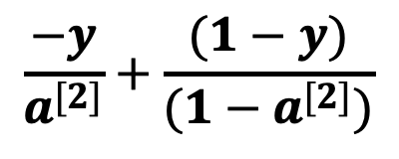
Backward Propagation
The derivatives can be computed by moving from right to left
$$b^{[2]}$$
$$b^{[1]}$$
$$W^{[2]}$$
$$x$$
$$z^{[1]}=w^{[1] }x+b^{[1]}$$
$$a^{[1]}=σ(z^{[1]})$$
$$z^{[2]}=w^{[2] }a^{[1]}+b^{[2]}$$
$$a^{[2]}=σ(z^{[2]})$$
$$𝓛(a^{[2]},y)$$
$$W^{[1]}$$
$$\frac{−y}{a^{[2]}}+\frac{(1−y)}{(1−a^{[2]})}$$
$$\frac{∂𝓛}{∂a^{[2]}}=\frac{∂}{∂a}\left(−ylog\left(a\right)−\left(1−y\right)log\left(1−a\right)\right)$$

Slide 26
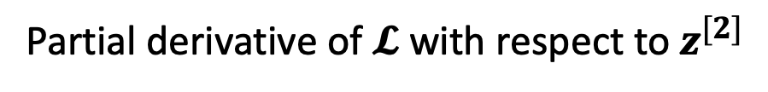

Backward Propagation
The derivatives can be computed by moving from right to left
$$b^{[2]}$$
$$b^{[1]}$$
$$W^{[2]}$$
$$x$$
$$z^{[1]}=w^{[1] }x+b^{[1]}$$
$$a^{[1]}=σ(z^{[1]})$$
$$z^{[2]}=w^{[2] }a^{[1]}+b^{[2]}$$
$$a^{[2]}=σ(z^{[2]})$$
$$𝓛(a^{[2]},y)$$
$$W^{[1]}$$
$$\frac{∂𝓛}{∂z^{[2]}}=\frac{∂}{∂a}\left(−ylog\left(a\right)−\left(1−y\right)log\left(1−a\right)\right)$$
Partial derivative of $𝓛$ with respect to $z^{[2]}$

Slide 27


Backward Propagation
The derivatives can be computed by moving from right to left
$$b^{[2]}$$
$$b^{[1]}$$
$$W^{[2]}$$
$$x$$
$$z^{[1]}=w^{[1] }x+b^{[1]}$$
$$a^{[1]}=σ(z^{[1]})$$
$$z^{[2]}=w^{[2] }a^{[1]}+b^{[2]}$$
$$a^{[2]}=σ(z^{[2]})$$
$$𝓛(a^{[2]},y)$$
$$W^{[1]}$$
$$\frac{∂𝓛}{∂a^{[2]}}×\frac{∂a^{[2]}}{∂z^{[2]}}$$
$$\frac{∂𝓛}{∂z^{[2]}}=\frac{∂}{∂a}\left(−ylog\left(a\right)−\left(1−y\right)log\left(1−a\right)\right)$$
$${=a}^{[2]}−y$$

Slide 28


Backward Propagation
The derivatives can be computed by moving from right to left
$$b^{[2]}$$
$$b^{[1]}$$
$$W^{[2]}$$
$$x$$
$$z^{[1]}=w^{[1] }x+b^{[1]}$$
$$a^{[1]}=σ(z^{[1]})$$
$$z^{[2]}=w^{[2] }a^{[1]}+b^{[2]}$$
$$a^{[2]}=σ(z^{[2]})$$
$$𝓛(a^{[2]},y)$$
$$W^{[1]}$$
$$\frac{∂𝓛}{∂b^{[2]}}=\frac{∂}{∂a}\left(−ylog\left(a\right)−\left(1−y\right)log\left(1−a\right)\right)$$
Partial derivative of $𝓛$ with respect to $b^{[2]}$

Slide 29


Backward Propagation
The derivatives can be computed by moving from right to left
$$b^{[2]}$$
$$b^{[1]}$$
$$W^{[2]}$$
$$x$$
$$z^{[1]}=w^{[1] }x+b^{[1]}$$
$$a^{[1]}=σ(z^{[1]})$$
$$z^{[2]}=w^{[2] }a^{[1]}+b^{[2]}$$
$$a^{[2]}=σ(z^{[2]})$$
$$𝓛(a^{[2]},y)$$
$$W^{[1]}$$
$$\frac{∂𝓛}{∂a^{[2]}}×\frac{∂a^{[2]}}{∂z^{[2]}}×\frac{∂z^{[2]}}{∂b^{[2]}}$$
$$\frac{∂𝓛}{∂b^{[2]}}=\frac{∂}{∂a}\left(−ylog\left(a\right)−\left(1−y\right)log\left(1−a\right)\right)$$
$${=a}^{[2]}−y$$

Slide 30


Backward Propagation
The derivatives can be computed by moving from right to left
$$b^{[2]}$$
$$b^{[1]}$$
$$W^{[2]}$$
$$x$$
$$z^{[1]}=w^{[1] }x+b^{[1]}$$
$$a^{[1]}=σ(z^{[1]})$$
$$z^{[2]}=w^{[2] }a^{[1]}+b^{[2]}$$
$$a^{[2]}=σ(z^{[2]})$$
$$𝓛(a^{[2]},y)$$
$$W^{[1]}$$
$$\frac{∂𝓛}{∂W^{[2]}}=\frac{∂}{∂a}\left(−ylog\left(a\right)−\left(1−y\right)log\left(1−a\right)\right)$$
Partial derivative of $𝓛$ with respect to $W^{[2]}$

Slide 31


Backward Propagation
The derivatives can be computed by moving from right to left
$$b^{[2]}$$
$$b^{[1]}$$
$$W^{[2]}$$
$$x$$
$$z^{[1]}=w^{[1] }x+b^{[1]}$$
$$a^{[1]}=σ(z^{[1]})$$
$$z^{[2]}=w^{[2] }a^{[1]}+b^{[2]}$$
$$a^{[2]}=σ(z^{[2]})$$
$$𝓛(a^{[2]},y)$$
$$W^{[1]}$$
$$\frac{∂𝓛}{∂a^{[2]}}×\frac{∂a^{[2]}}{∂z^{[2]}}×\frac{∂z^{[2]}}{∂W^{[2]}}$$
$$\frac{∂𝓛}{∂W^{[2]}}=\frac{∂}{∂a}\left(−ylog\left(a\right)−\left(1−y\right)log\left(1−a\right)\right)$$
$$=(a^{[2]}−y)a^{\left[1\right]T}$$

Slide 32


Backward Propagation
The derivatives can be computed by moving from right to left
$$b^{[2]}$$
$$b^{[1]}$$
$$W^{[2]}$$
$$x$$
$$z^{[1]}=w^{[1] }x+b^{[1]}$$
$$a^{[1]}=σ(z^{[1]})$$
$$z^{[2]}=w^{[2] }a^{[1]}+b^{[2]}$$
$$a^{[2]}=σ(z^{[2]})$$
$$𝓛(a^{[2]},y)$$
$$W^{[1]}$$
$$\frac{∂𝓛}{∂a^{[1]}}=\frac{∂}{∂a}\left(−ylog\left(a\right)−\left(1−y\right)log\left(1−a\right)\right)$$
Partial derivative of $𝓛$ with respect to $a^{[1]}$

Slide 33


Backward Propagation
The derivatives can be computed by moving from right to left
$$b^{[2]}$$
$$b^{[1]}$$
$$W^{[2]}$$
$$x$$
$$z^{[1]}=w^{[1] }x+b^{[1]}$$
$$a^{[1]}=σ(z^{[1]})$$
$$z^{[2]}=w^{[2] }a^{[1]}+b^{[2]}$$
$$a^{[2]}=σ(z^{[2]})$$
$$𝓛(a^{[2]},y)$$
$$W^{[1]}$$
$$\frac{∂𝓛}{∂a^{[2]}}×\frac{∂a^{[2]}}{∂z^{[2]}}×\frac{∂z^{[2]}}{∂a^{[1]}}$$
$$\frac{∂𝓛}{∂a^{[1]}}=\frac{∂}{∂a}\left(−ylog\left(a\right)−\left(1−y\right)log\left(1−a\right)\right)$$
$$=(a^{[2]}−y)w^{\left[2\right]T}$$

Slide 34


Backward Propagation
The derivatives can be computed by moving from right to left
$$b^{[2]}$$
$$b^{[1]}$$
$$W^{[2]}$$
$$x$$
$$z^{[1]}=w^{[1] }x+b^{[1]}$$
$$a^{[1]}=σ(z^{[1]})$$
$$z^{[2]}=w^{[2] }a^{[1]}+b^{[2]}$$
$$a^{[2]}=σ(z^{[2]})$$
$$𝓛(a^{[2]},y)$$
$$W^{[1]}$$
$$\frac{∂𝓛}{∂z^{[1]}}=\frac{∂}{∂a}\left(−ylog\left(a\right)−\left(1−y\right)log\left(1−a\right)\right)$$
Partial derivative of $𝓛$ with respect to $z^{[1]}$

Slide 35


Backward Propagation
The derivatives can be computed by moving from right to left
$$b^{[2]}$$
$$b^{[1]}$$
$$W^{[2]}$$
$$x$$
$$z^{[1]}=w^{[1] }x+b^{[1]}$$
$$a^{[1]}=σ(z^{[1]})$$
$$z^{[2]}=w^{[2] }a^{[1]}+b^{[2]}$$
$$a^{[2]}=σ(z^{[2]})$$
$$𝓛(a^{[2]},y)$$
$$W^{[1]}$$
$$\frac{∂𝓛}{∂a^{[2]}}×\frac{∂a^{[2]}}{∂z^{[2]}}×\frac{∂z^{[2]}}{∂a^{[1]}}×\frac{∂a^{[1]}}{∂z^{[1]}}$$
$$\frac{∂𝓛}{∂z^{[1]}}=\frac{∂}{∂a}\left(−ylog\left(a\right)−\left(1−y\right)log\left(1−a\right)\right)$$
$$=\left(a^{\left[2\right]}−y\right)w^{\left[2\right]T}∗a^{[1]}(1−a^{[1]})$$
Element-wise product

Slide 36


Backward Propagation
The derivatives can be computed by moving from right to left
$$b^{[2]}$$
$$b^{[1]}$$
$$W^{[2]}$$
$$x$$
$$z^{[1]}=w^{[1] }x+b^{[1]}$$
$$a^{[1]}=σ(z^{[1]})$$
$$z^{[2]}=w^{[2] }a^{[1]}+b^{[2]}$$
$$a^{[2]}=σ(z^{[2]})$$
$$𝓛(a^{[2]},y)$$
$$W^{[1]}$$
$$\frac{∂𝓛}{∂a^{[2]}}×\frac{∂a^{[2]}}{∂z^{[2]}}×\frac{∂z^{[2]}}{∂a^{[1]}}×\frac{∂a^{[1]}}{∂z^{[1]}}×\frac{∂z^{[1]}}{∂b^{[1]}}$$
$$\frac{∂𝓛}{∂b^{[1]}}=\frac{∂}{∂a}\left(−ylog\left(a\right)−\left(1−y\right)log\left(1−a\right)\right)$$

Slide 37

Backward Propagation
The derivatives can be computed by moving from right to left
$$b^{[2]}$$
$$b^{[1]}$$
$$W^{[2]}$$
$$x$$
$$z^{[1]}=w^{[1] }x+b^{[1]}$$
$$a^{[1]}=σ(z^{[1]})$$
$$z^{[2]}=w^{[2] }a^{[1]}+b^{[2]}$$
$$a^{[2]}=σ(z^{[2]})$$
$$𝓛(a^{[2]},y)$$
$$W^{[1]}$$
$$\frac{∂𝓛}{∂b^{[1]}}=\frac{∂}{∂a}\left(−ylog\left(a\right)−\left(1−y\right)log\left(1−a\right)\right)$$
$$\left(a^{\left[2\right]}−y\right)w^{\left[2\right]T}∗a^{[1]}(1−a^{[1]})$$

Slide 38


Backward Propagation
The derivatives can be computed by moving from right to left
$$b^{[2]}$$
$$b^{[1]}$$
$$W^{[2]}$$
$$x$$
$$z^{[1]}=w^{[1] }x+b^{[1]}$$
$$a^{[1]}=σ(z^{[1]})$$
$$z^{[2]}=w^{[2] }a^{[1]}+b^{[2]}$$
$$a^{[2]}=σ(z^{[2]})$$
$$𝓛(a^{[2]},y)$$
$$W^{[1]}$$
$$\frac{∂𝓛}{∂a^{[2]}}×\frac{∂a^{[2]}}{∂z^{[2]}}×\frac{∂z^{[2]}}{∂a^{[1]}}×\frac{∂a^{[1]}}{∂z^{[1]}}×\frac{∂z^{[1]}}{∂W^{[1]}}$$
$$\frac{∂𝓛}{∂W^{[1]}}=\frac{∂}{∂a}\left(−ylog\left(a\right)−\left(1−y\right)log\left(1−a\right)\right)$$

Slide 39

Backward Propagation
The derivatives can be computed by moving from right to left
$$b^{[2]}$$
$$b^{[1]}$$
$$W^{[2]}$$
$$x$$
$$z^{[1]}=w^{[1] }x+b^{[1]}$$
$$a^{[1]}=σ(z^{[1]})$$
$$z^{[2]}=w^{[2] }a^{[1]}+b^{[2]}$$
$$a^{[2]}=σ(z^{[2]})$$
$$𝓛(a^{[2]},y)$$
$$W^{[1]}$$
$$\frac{∂𝓛}{∂W^{[1]}}=\frac{∂}{∂a}\left(−ylog\left(a\right)−\left(1−y\right)log\left(1−a\right)\right)$$
$$\left(\left(a^{\left[2\right]}−y\right)w^{\left[2\right]T}∗a^{\left[1\right]}\left(1−a^{\left[1\right]}\right)\right)x^{T}$$

Slide 40














Backward Propagation: Summary
Here is the summary of the gradients in our given neural network:
$$\frac{∂𝓛}{∂z^{[2]}}{=a}^{[2]}−y$$
$$dz^{[1]}=$$
$$\frac{∂𝓛}{∂z^{[1]}}=dz^{[2]}w^{\left[2\right]T}∗a^{[1]}(1−a^{[1]})$$
$$dz^{[2]}=$$
$$db^{[2]}=$$
$$\frac{∂𝓛}{∂b^{[2]}}{=a}^{[2]}−y$$
$$\frac{∂𝓛}{∂b^{[1]}}=\frac{∂}{∂a}\left(−ylog\left(a\right)−\left(1−y\right)log\left(1−a\right)\right)$$
$$db^{[1]}=$$
$$dz^{[2]}w^{\left[2\right]T}∗a^{[1]}(1−a^{[1]})$$
$$\frac{∂𝓛}{∂W^{[2]}}=(a^{[2]}−y)a^{\left[1\right]T}$$
$$\frac{∂𝓛}{∂W^{[1]}}=\frac{∂}{∂a}\left(−ylog\left(a\right)−\left(1−y\right)log\left(1−a\right)\right)$$
$$dW^{[2]}=$$
$$dW^{[1]}=$$
$$\left(dz^{[2]}w^{\left[2\right]T}∗a^{\left[1\right]}\left(1−a^{\left[1\right]}\right)\right)x^{T}$$

Slide 41
The End.
Thank you!

